Slide 1

DIGITAL PORTFOLIO
STUDENT NAME : ANANTH R
REGISTER NO : 212400388
NMID : C15A1FFC8BE18D19A244DC2F3B223C1
DEPARTMENT : BCA
COLLEGE : SINDHI COLLEGE
UNIVERSITY : MADRAS UNIVERSITY

Slide 2
Digital Portfolio
.

Slide 3
AGENDA
1.Problem statement 6.Features and Functionality
2.Project overview 7.Results and Screenshots 3.End User 8.Conclusion 4.Tools and technologies 9.Github Link
5.Protfolio design and Layout
E

Slide 4
PROBLEM STATEMENT
1.Traditional resumes and paper portfolio are static and cannot fully represent a n individual’s skills and creativity.
2.Employers and educators often face difficulty evaluating candidates due to limited outdated presentation formats

Slide 5
PROJECT OVERVIEW
1 . OBJECTIVE - To create a professional online space that showcases personal skill , achievements , projects , and experiences in a structured and creative way.
2 . OUTCOME - A well-designed digital portfolio that highlights strengths and growth , making it easy to share with employers , educators , or clients.

Slide 6
WHO ARE THE END USERS
1 . Potential clients
2 . Hiring managers or recruiters
These individuals review the portfolio to assess the person’s skill, experience , and fit for a job or project

Slide 7
TOOLS AND TECHNOLOGIES
1 . WEB DEVELOPMENT TOOLS - HTML , CSS and JavaScript for designing and developing interactive portfolio pages
2 . DESIGN & PRESENTATION TOOLS - Canva , photoshop for creating visually appealing layouts , graphics , and portfolio designs.

Slide 8
PORTFOLIO DESIGN AND LAYOUT
1 .USER FRIENDLY NAVIGATION - The layout should be simple and easy to explore so that viewers can quickly find information or projects.
2 . USE OF MULTIMEDIA - Include images, videos, and graphics in a neat layout to make the portfolio more attractive and engaging.

Slide 9
FEATURES AND FUNCTIONSLITY
1 . Interactive Elements- Clickable links, buttons, and project demos that engage viewers.
2 . Responsive Design- Portfolio adjust smoothly across devices like mobiles, tables, and desktops.

Slide 10
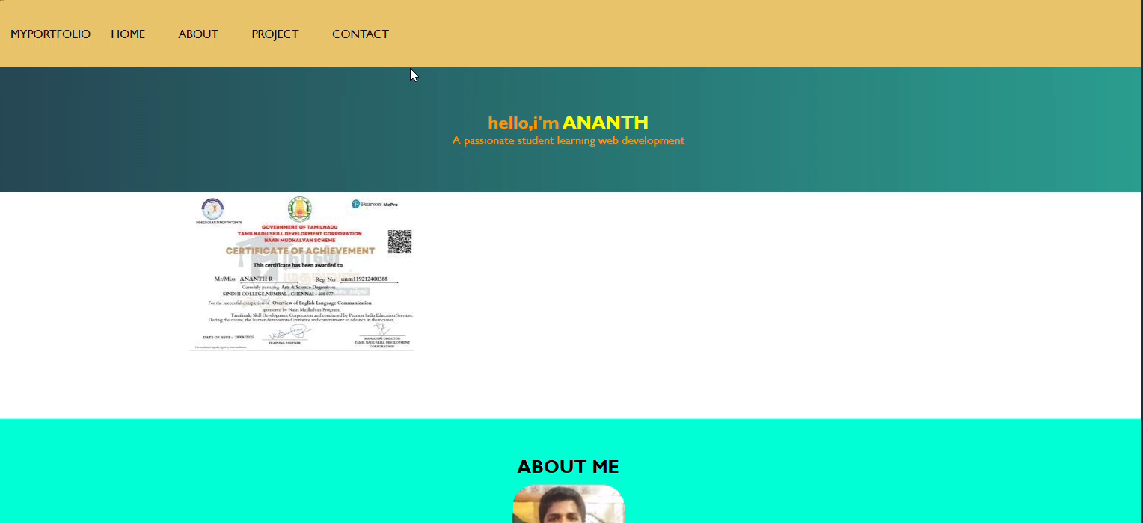
RESULT AND SCREENSHORTS

Slide 11
CONCLUSION
Digital portfolio effectively showcase skills , achievements , and creativity in an organized way , making it easier for others to understand one’s professional and personal growth.
It serves as long-term platform for self-improvement , continuous learning , and career opportunities.

